Slide 1
Development of an Embedded Communication Hub for the Acquisition of Sensor Data in a Robotic System
Project Thesis Juan Carlos Reyes Andrade, ICS
Rev 2 - Draft (2020.04.16)

Slide 2
Contents
Background, general overview
Main goal
Specific goals
Timeline proposal

Slide 3
Background
Still increasing robotic applications with multi-connectivity
Several Industrial Protocols in the last decades
Industrial shift into the Real Time Connectivity
Several private development of real time Ethernet industrial networks
TSN official attempt to integrate the technologies to an standard, as it happened with classical Ethernet
Open-source developed tools that offer compatibility with specific vendors.

Slide 4
Main goal
Develop a test device using open-source tools compatible with one of the current RT Ethernet Protocols, such that it can be used as a test platform in a real industrial environment to characterize its compatibility with TSN.

Slide 5
Specific goals
Analysis of requirements and needed IO interfaces for the system while taking into account the state of the art for RTE Industrial Networks
Develop the embedded system as a functional EtherCAT Slave Device with an approach to open-source tools (Communication hub, EtherCAT is one of the RTE Protocols)
Provide within the embedded system a platform capable of the following functions
Readout of different sensors e.g. IMU (SPI), Encoders (BiSS-C),…
Control of status RGB LEDs e.g. WS2812b (incl. animations)
Preprocessing data acquired by the sensors (e.g. filtering)
Design of a PCB prototype using Altium Designer
Test the system functionality

Slide 6
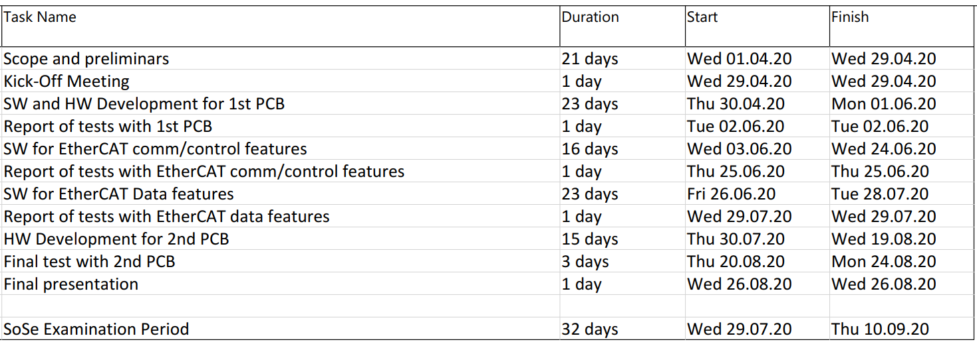
Timeline
Duration: 4 Months
Official start: 29.04 Final Presentation: 26.08 (Proposal)

Slide 7
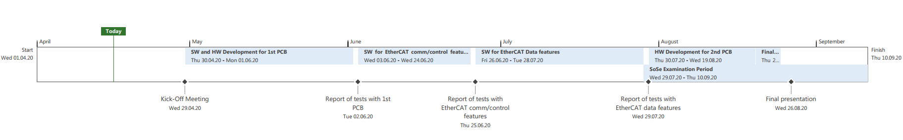
Timeline

Slide 8
Danke schön für Ihre Aufmerksamkeit!

Slide 9
Extra information

Slide 10
Main topics
Programming of software for embedded systems
STM32 MCUs with ARM architecture
Communication Interfaces (UART, I2C, BiSS, SPI)
Real Time tools (FreeRTOS - CMSIS)
Programming with industrial tools
Integration of an industrial protocol software stack into RTOS (SOES)
RT Ethernet Industrial Protocols (EtherCAT)
External configurations
EtherCAT Host (Beckhoff)
External documentations
TSN Industrial profile specification 2019

Slide 11
- [05.29] First PCB will be able to measure the temperature, interface over Uart to any serial host, control the LEDs and will only have the pinouts for SPI and BiSS connections. Tasks will be handled with a basic FreeRTOS approach. PCB will connect directly to the Nucleo and the LAN9252 Eval Board (firmly assambled, no-MCU on the manufactured board, 2X SPI Ports, 4X Temperature sensor connectors and X-Ports to LEDs).
- [06.24] First EtherCAT Slave Test - This will have at least a running framework for SPI communication, initial configuration of the LAN9252 Eval Board and a test data flow coming from the temperature sensor to the Master. It will run over the Nucleo Board.
- [07.24] Second EtherCAT Slave Test - This should exchange the data coming from sensors and saving/updating the control data coming from the Master. All the data should be structured according to the Robot application. Important to notice , the BiSS Encoder is not included in this version.
- [08.21] Second PCB - This PCB will improve the first version having the MCU considered to replace the attached Nucleo Board and adding any component that might be needed for signal instrumentation. Any code improvement could be also added to adjust the several ports considered in the PCB design.
- [08.26-28] Final Presentation - Mainly it would be focused on the integration of SOES with the RTOS to create a device that will be the base for a future performance analysis within TSNs for industrial applications. Also the current status of the TSN initiative and any discussion that might appear due to the employment of open-source tools.

